Slide 1
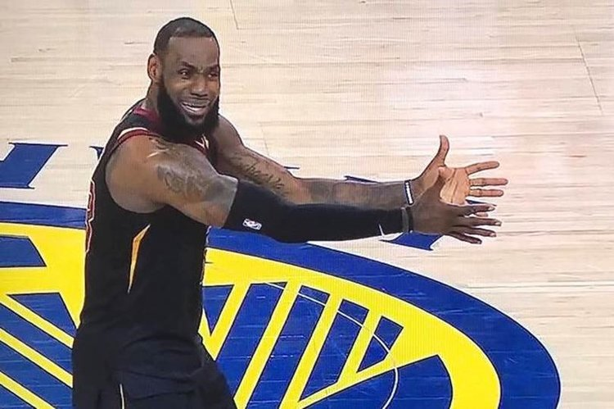
Predicting an NBA Player’s Salary
Bradley Chen, Lingrui Fan, Sean Ream
Notes:
sean

Slide 2
Motivation
NBA players are some of the highest paid athletes
Dozens of player statistics
Which ones really matter?
Notes:
sean

Slide 3
Our Dataset
Salary information gathered from NBA and Basketball Reference website
Covers 2017-2018 season
651 entries including players from 44 countries
Source
Notes:
sean
Mention that there are some repeats since some players switch teams in the middle of the season

Slide 4
Variables Chosen
Picked variables representing key indicators of performance from players
Personal statistics of players including in game statistics as well as age, draft number, and other factors
Notes:
sean

Slide 5
Variables Chosen (cont.)
The Variables considered included Games played, age, position of player, True Shooting percentage of player, Assist percentage, Steal percentage, Offensive rebound percentage, Defensive rebound percentage, Player efficiency rating, Minutes played, Value over replaced player is the estimated increase or decrease in contribution that a player provides over who he replaced, Win shares, and the player’s draft number
Notes:
leo

Slide 6
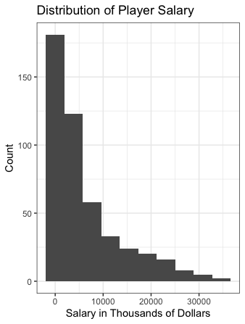
Variable Cleanup
Removed non-US players
Removed players with $0 salary
Distribution of salary strongly
skewed right
Notes:
leo

Slide 7
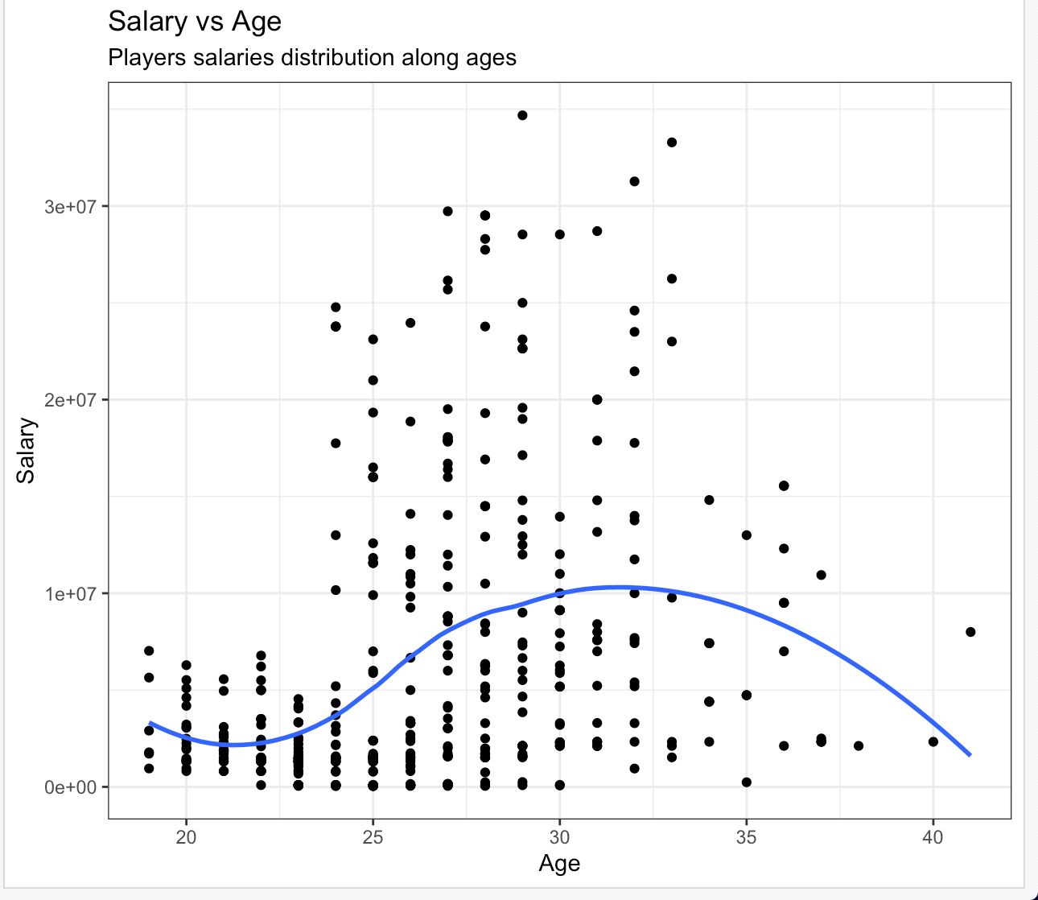
Initial Model Analysis
Multiple linear models regressing the log of salary on single variables to see the effect of them on salary without controlling for other variables
One of the more important variables age was used first to check the relation with salary
Other models were used to check which variables were significant on their own for predicting salary of players and to check residuals
Some of these included Games played, shooting percentage, assist percentage etc...
Notes:
leo

Slide 8
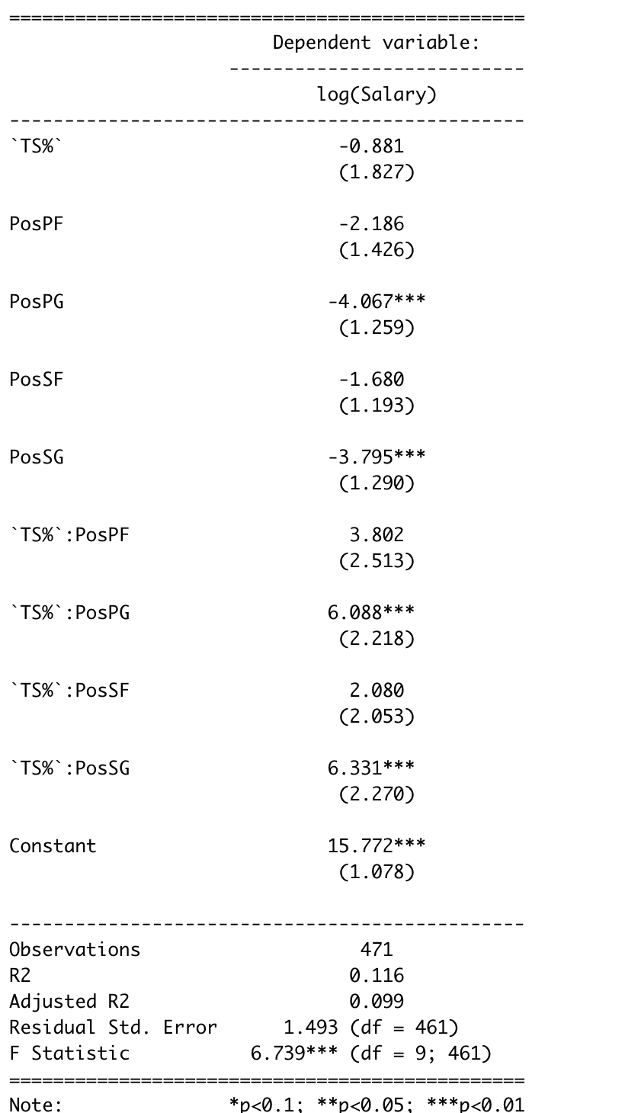
Effect Position Has On Predicting Salary Using True Shooting %
Interpretations:
The true shooting percentage is affecting salary more significantly through positions Point Guard (PG) and Shooting Guard (SG).
The true shooting percentage is also marginally more valuable on Point Guard and Shooting Guard than others.
Notes:
leo

Slide 9
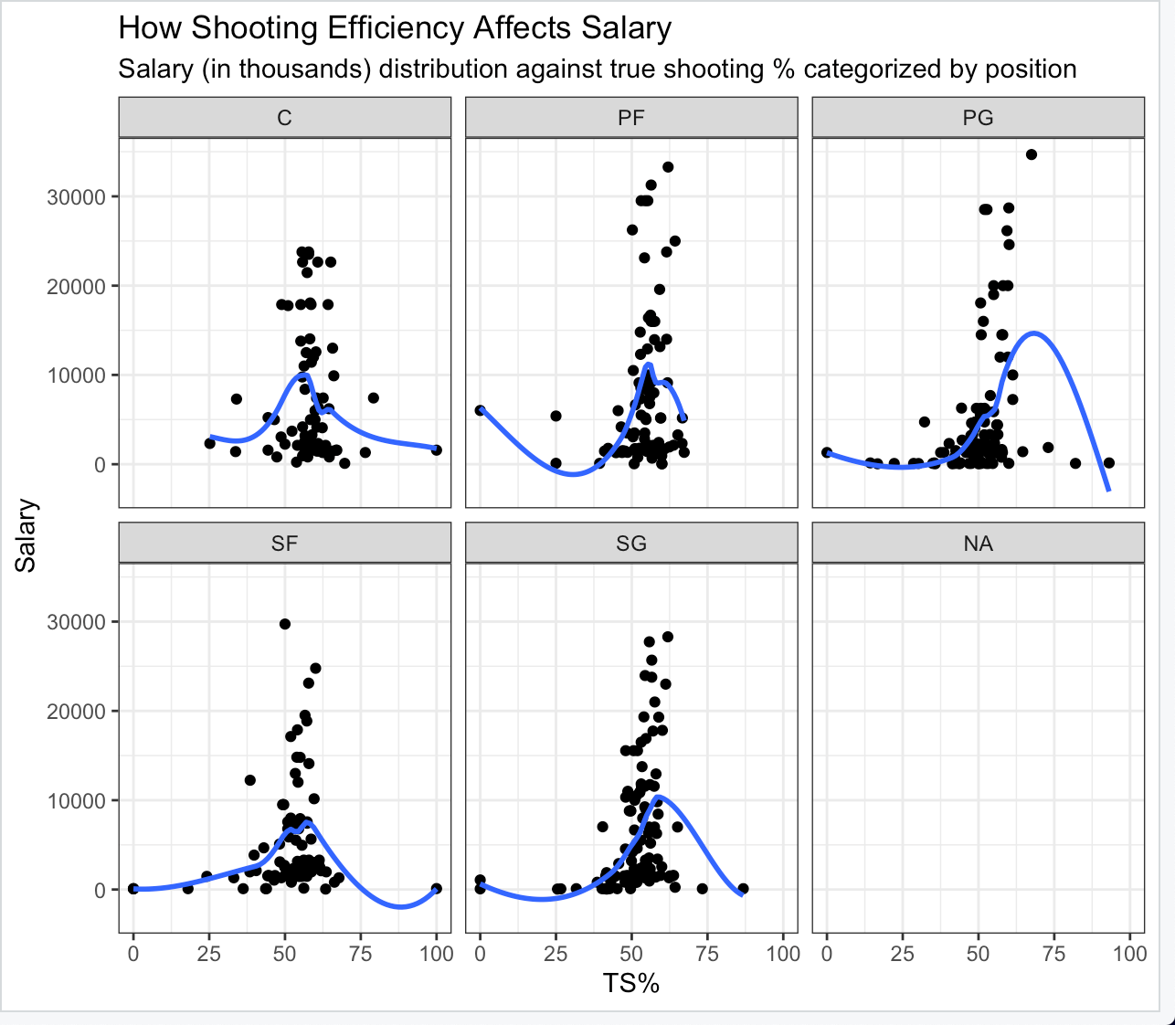
Notes:
leo

Slide 10
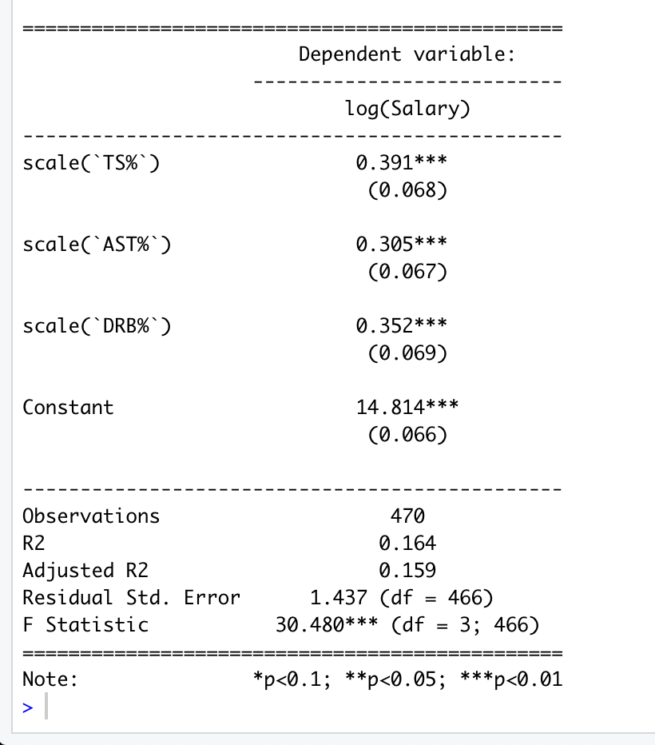
Game Performance effect on Salary Model
Interpretations
Intercept: A player with average true shot percentage, average assist percentage, and average defensive rebound percentage has a salary of $2,714,178
TS%: A 1% increase in True shooting percentage is associated with a 0.391% increase in salary for a player with average assist and defensive rebound percentages
AST%: A 1% increase in assist percentage corresponds with a 0.305% increase increase in salary for a player with average true shooting percentage and average defensive rebounds.
DRB%: A 1% increase increase in defensive rebound percentage corresponds with a 0.352% increase in salary for a player with average true shooting percentage and average assist percentage
Notes:
sean

Slide 11
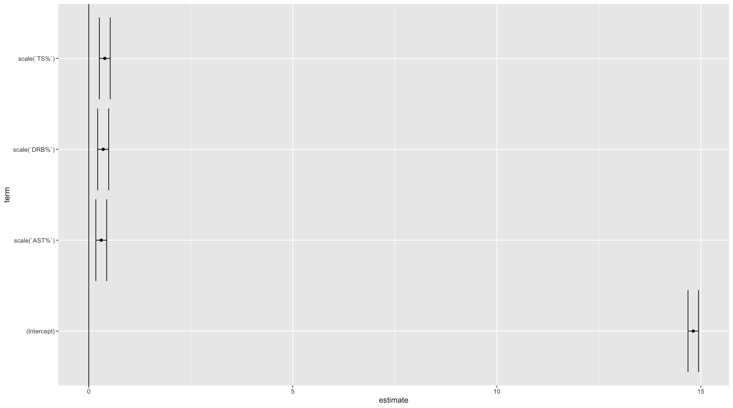
Game Performance effect on Salary Model
Notes:
sean

Slide 12
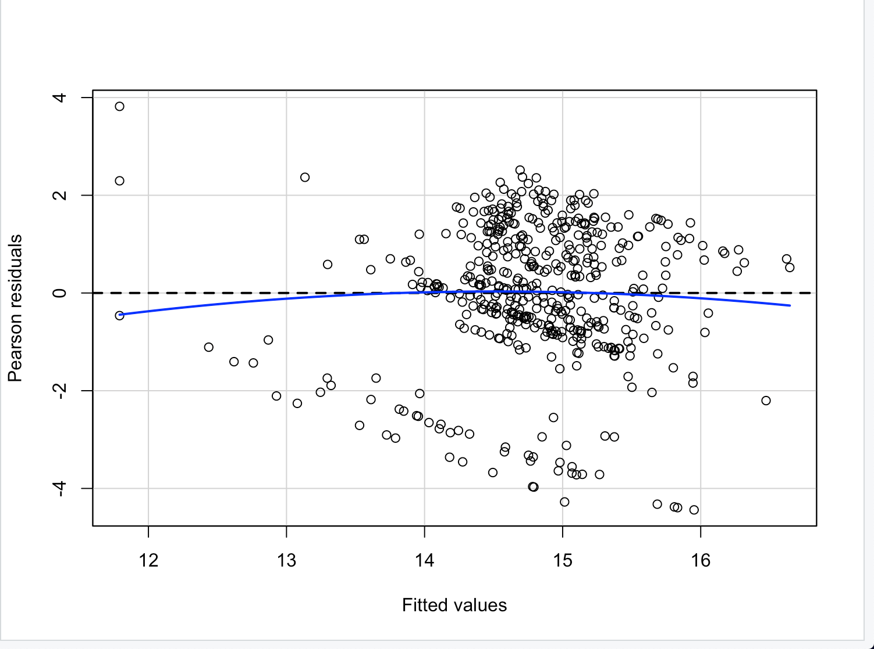
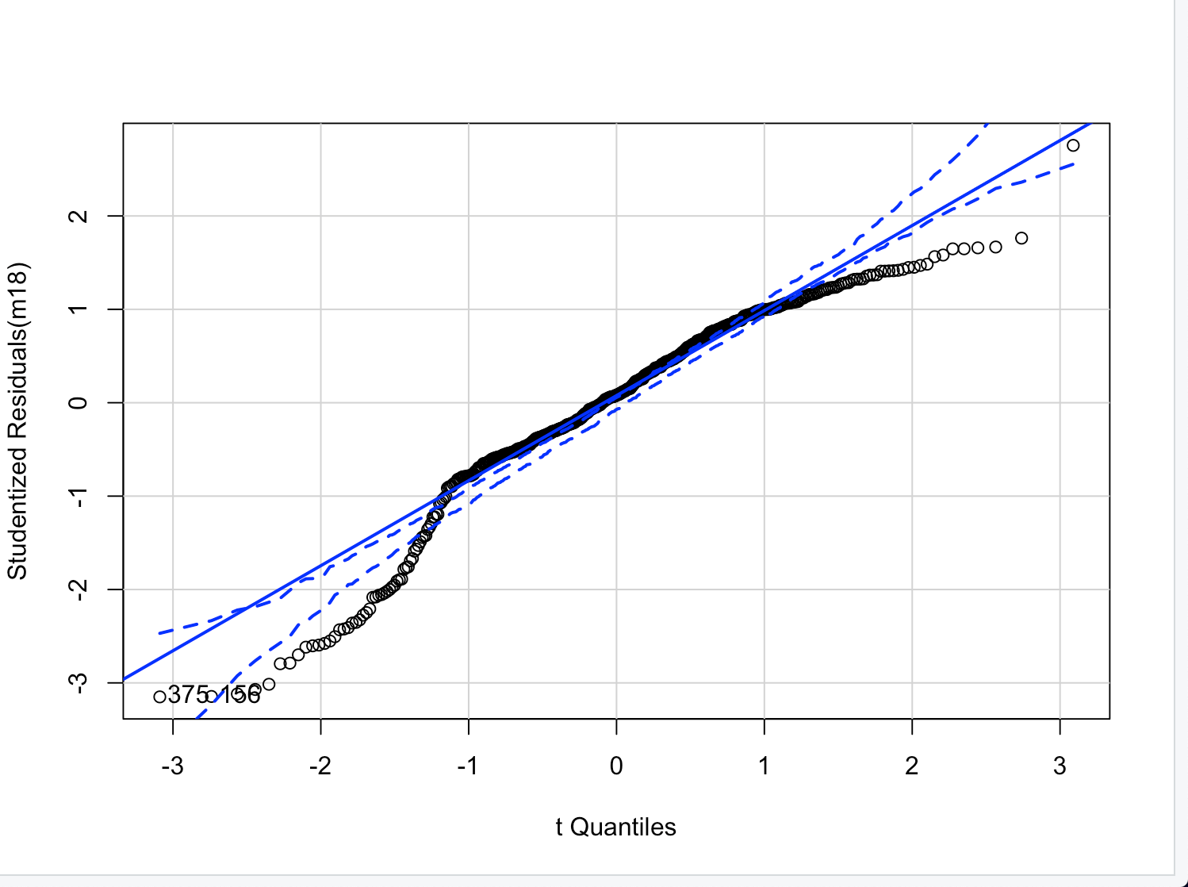
Diagnostics
VIFs: scale(`TS%`) scale(`AST%`) scale(`DRB%`)
1.047396 1.038654 1.074075
Notes:
sean

Slide 13
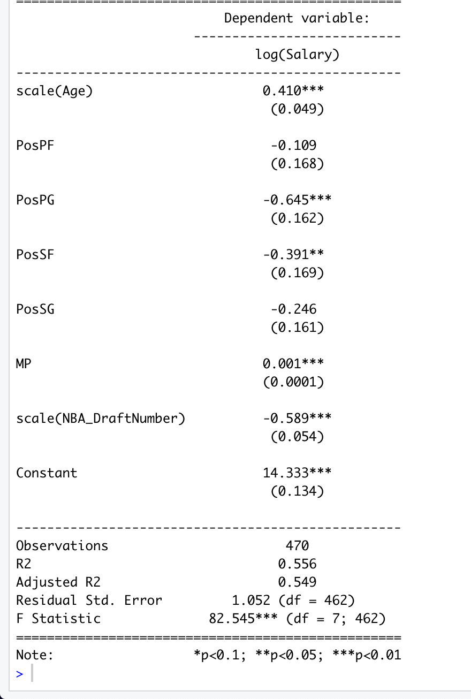
Predicting Salary From Player Information
Interpretations
Intercept: A player who is a center with average age, 0 minutes played and an average draft number will earn $1,677,810
Position: A small forward of average age with 0 minutes played and an average draft number will have a salary that is 0.391% lower than a center and a point guard of average age with 0 minutes played and an average draft number will have a salary that is 0.645% lower than a center
Age: For each additional year of age, salary goes up by 0.41% for a player who is a center that had an average draft number and 0 minutes played.
MP: Each additional minute played is associated with an increase in salary of 0.001% for a player who is a center of average age with an average draft number.
Draft Number: For each unit increase in a player’s draft number, his salary decreases by 0.589% for a player who is a center with 0 minutes played and of average age.
Notes:
bradley

Slide 14
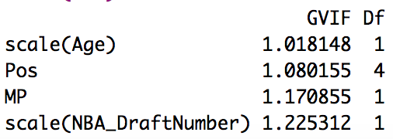
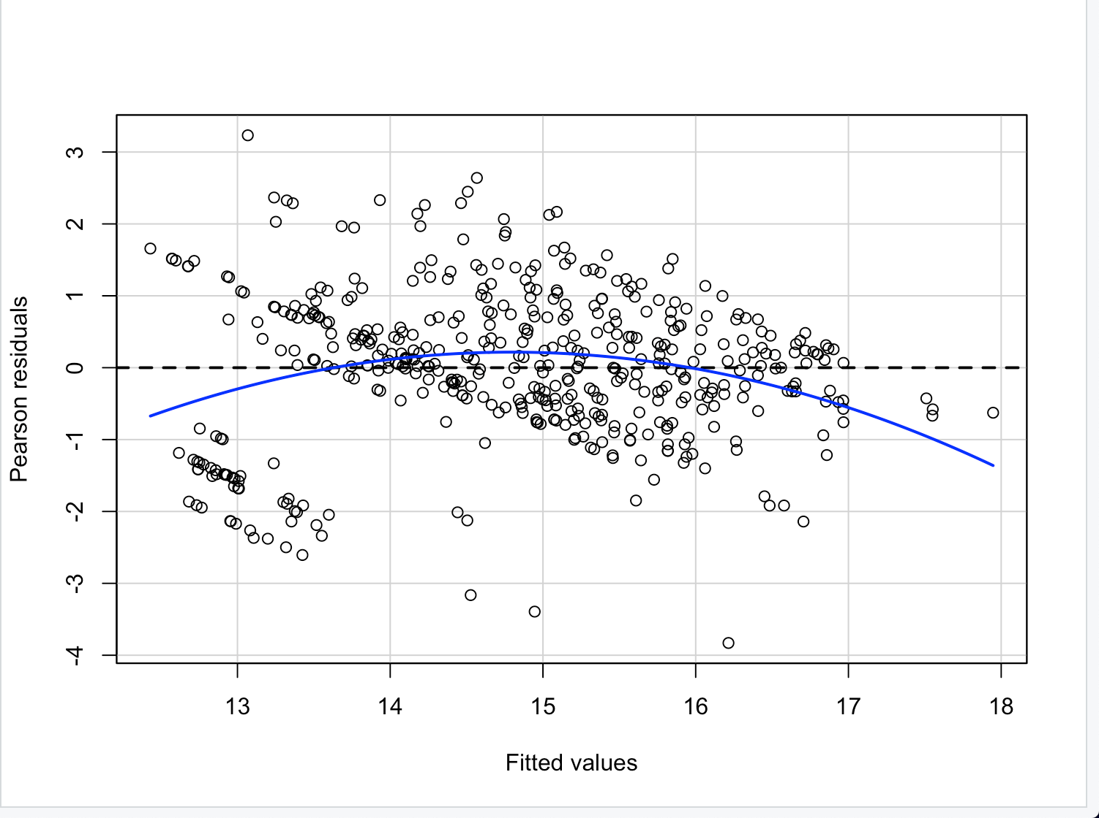
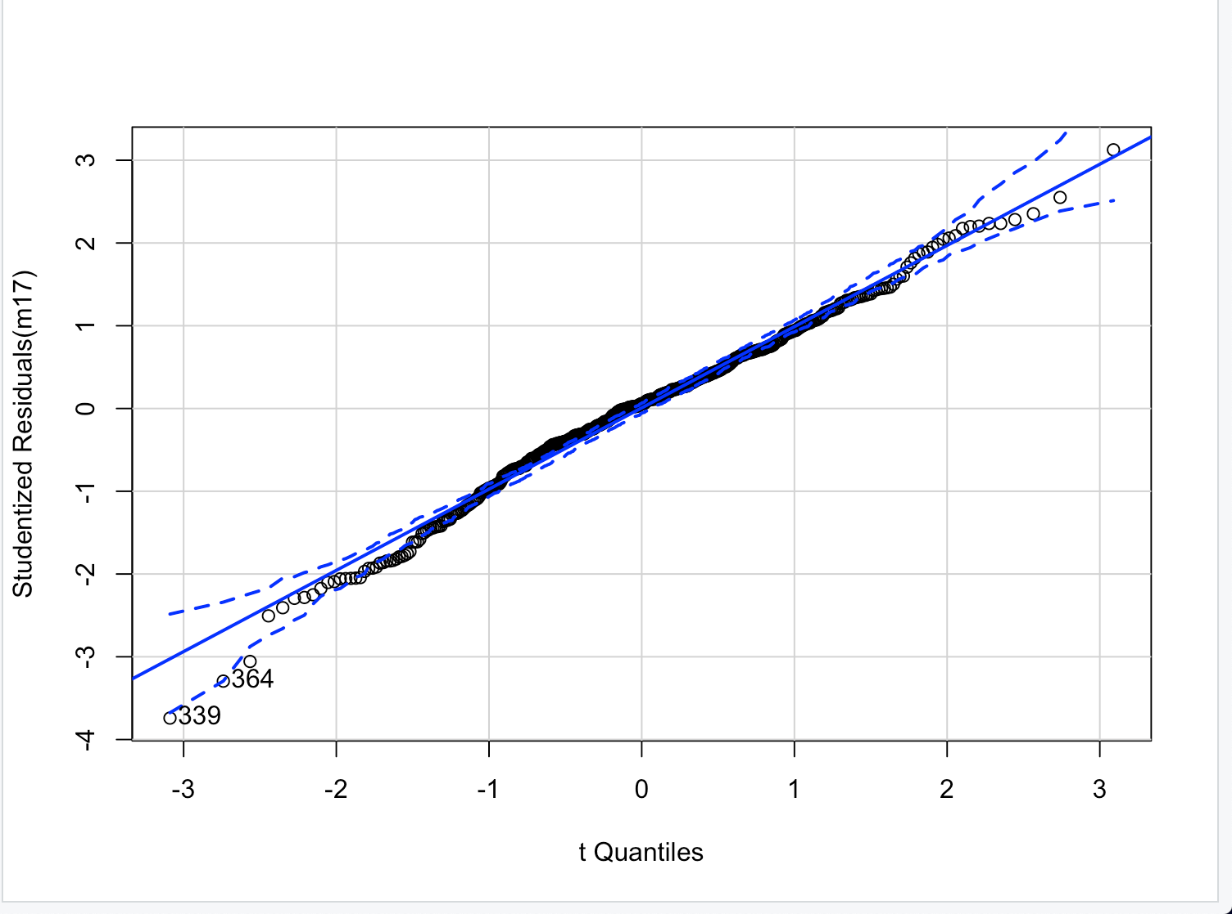
Diagnostics
Notes:
Bradley
There is some heteroskedasticity in the residual plot, however it’s not too bad considering this is raw data. When we look at the qqplot, we see that the residuals are normally distributed. The VIF numbers are also under 2.5, meaning that there is no multicollinearity

Slide 15
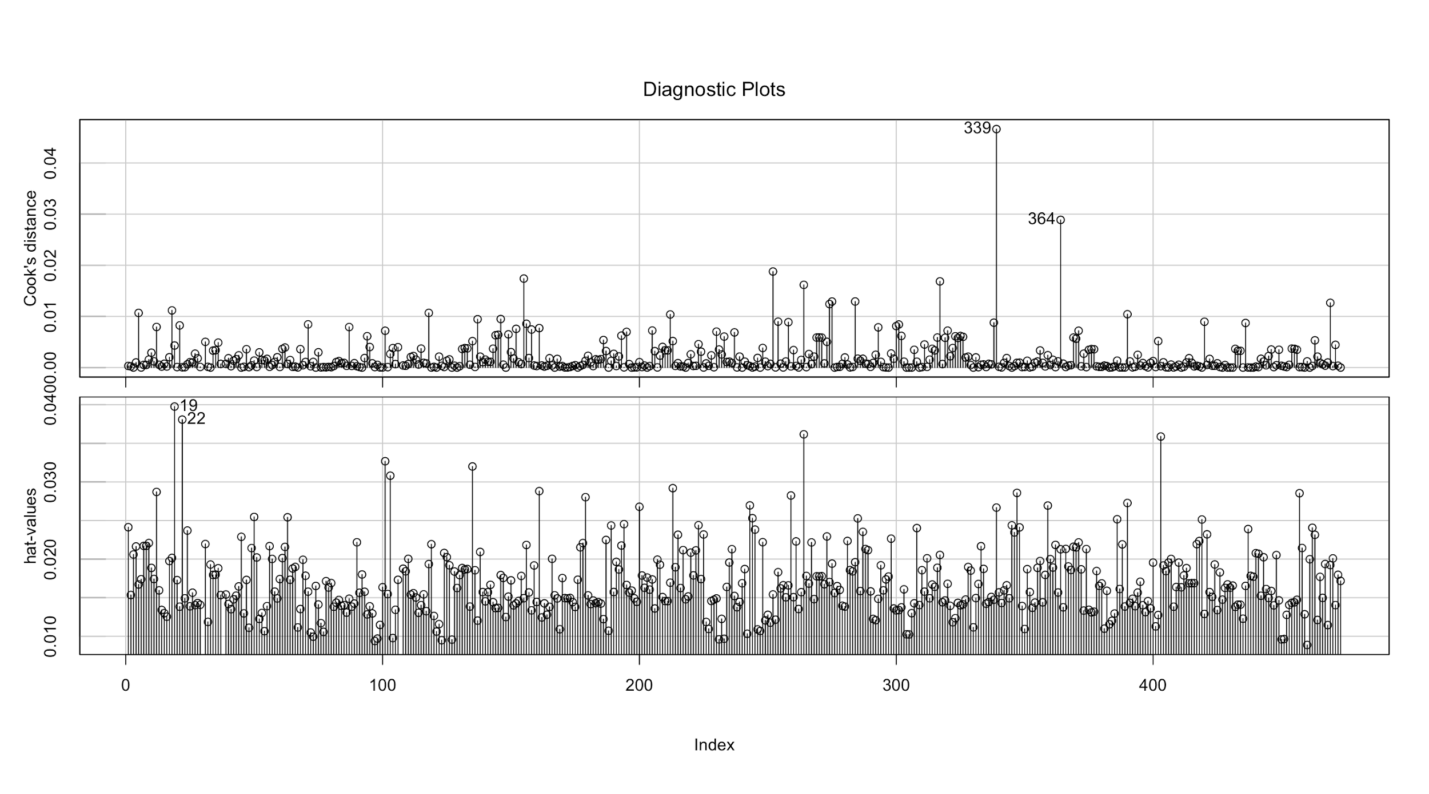
Diagnostics (Cont.)
Notes:
Bradley
The cooks distance is well under 0.5 so there are no problems there but in terms of hat values there are a couple problematic values

Slide 16
Key Takeaways
Peak salary occurs between 30 and 35 years of age
An increase in true shooting percentage is associated with the largest increase to a player’s salary for player stats
A player who is a center is associated with the largest salary compared to the other four positions
Low draft numbers are associated with significantly higher salary than high draft numbers
Notes:
bradley

